Slide 1
Basic Design Structure
Lesson 1B

Slide 2
Understanding algorithms
Duration :3 Hours
Period : Week 2 Day 1

Slide 3
Learning Outcomes:
By the end of the lesson, students ,must be able to:
Define an algorithm and explain what it is used for.
Identify inputs, processes and outputs needed to construct an algorithm.
Draw an IPO chart for a given problem.
Identify the algorithmic structures needed to produce a feasible algorithm to solve a given problem.
Recap
Notes:
Tip: Add your own speaker notes here.

Slide 4
What is an algorithm?
An algorithm is a well-defined step by step solution or a series of instructions to solve a problem.
Notes:
In computer science, the word algorithm refers to a special method useable by a computer for solution of a problem. The statement of the problem specifies in general terms the desired input/output relationship.
For example, sorting a given sequence of numbers into nondecreasing order provides fertile ground for introducing many standard design techniques and analysis tools.

Slide 5
Algorithm classification
Algorithms that use a similar problem-solving approach can be grouped together
This classification scheme is neither exhaustive nor disjoint
The purpose is not to be able to classify an algorithm as one type or another, but to highlight the various ways in which a problem can be attacked

Slide 6
Different kinds of algorithms
Greedy algorithms
Brute force algorithms
Divide and conquer algorithm
Dynamic programming algorithm
Simple recursive algorithms
Randomised algorithms
Notes:
Brute force algorithms-Which are straight forward trial and error approach of solving problems?
Greedy algorithms- Which follow a problem-solving heuristic to reach the next best state to find the final best state as the result.
Divide and conquer algorithm- Which break the problem into small sub problems and then combine the result of each sub problem to get the final result.
Dynamic programming-An approach which is same as divide and conquers but divides the problem into sub problems such that their results are reusable for other sub problems.
Simple recursive algorithms -A simple recursive algorithm:
Solves the base cases directly
Recurs with a simpler subproblem
Does some extra work to convert the solution to the simpler subproblem into a solution to the given problem
I call these “simple” because several of the other algorithm types are inherently recursive

Slide 7
Example recursive algorithms
To count the number of elements in a list:
If the list is empty, return zero; otherwise,
Step past the first element, and count the remaining elements in the list
Add one to the result
To test if a value occurs in a list:
If the list is empty, return false; otherwise,
If the first thing in the list is the given value, return true; otherwise
Step past the first element, and test whether the value occurs in the remainder of the list

Slide 8
Backtracking algorithms
Backtracking algorithms are based on a depth-first recursive search
A backtracking algorithm:
Tests to see if a solution has been found, and if so, returns it; otherwise
For each choice that can be made at this point,
Make that choice
Recur
If the recursion returns a solution, return it
If no choices remain, return failure

Slide 9
Example backtracking algorithm
To color a map with no more than four colors:
color(Country n)
If all countries have been colored (n > number of countries) return success; otherwise,
For each color c of four colors,
If country n is not adjacent to a country that has been colored c
Color country n with color c
recursivly color country n+1
If successful, return success
Return failure (if loop exits)

Slide 10
Divide and Conquer
A divide and conquer algorithm consists of two parts:
Divide the problem into smaller subproblems of the same type, and solve these subproblems recursively
Combine the solutions to the subproblems into a solution to the original problem
Traditionally, an algorithm is only called divide and conquer if it contains two or more recursive calls
Notes:
2

Slide 11
Examples
Quicksort:
Partition the array into two parts, and quicksort each of the parts
No additional work is required to combine the two sorted parts
Mergesort:
Cut the array in half, and mergesort each half
Combine the two sorted arrays into a single sorted array by merging them
Notes:
3

Slide 12
Binary tree lookup
Here’s how to look up something in a sorted binary tree:
Compare the key to the value in the root
If the two values are equal, report success
If the key is less, search the left subtree
If the key is greater, search the right subtree
This is not a divide and conquer algorithm because, although there are two recursive calls, only one is used at each level of the recursion
Notes:
4

Slide 13
Fibonacci numbers
To find the n^{th} Fibonacci number:
If n is zero or one, return one; otherwise,
Compute fibonacci(n-1) and fibonacci(n-2)
Return the sum of these two numbers
This is an expensive algorithm
It requires O(fibonacci(n)) time
This is equivalent to exponential time, that is, O(2^{n})

Slide 14
Dynamic programming algorithms
A dynamic programming algorithm remembers past results and uses them to find new results
Dynamic programming is generally used for optimization problems
Multiple solutions exist, need to find the “best” one
Requires “optimal substructure” and “overlapping subproblems”
Optimal substructure: Optimal solution contains optimal solutions to subproblems
Overlapping subproblems: Solutions to subproblems can be stored and reused in a bottom-up fashion
This differs from Divide and Conquer, where subproblems generally need not overlap

Slide 15
Fibonacci numbers again
To find the n^{th} Fibonacci number:
If n is zero or one, return one; otherwise,
Compute, or look up in a table, fibonacci(n-1) and fibonacci(n-2)
Find the sum of these two numbers
Store the result in a table and return it
Since finding the n^{th} Fibonacci number involves finding all smaller Fibonacci numbers, the second recursive call has little work to do
The table may be preserved and used again later

Slide 16
Greedy algorithms
An optimization problem is one in which you want to find, not just a solution, but the best solution
A “greedy algorithm” sometimes works well for optimization problems
A greedy algorithm works in phases: At each phase:
You take the best you can get right now, without regard for future consequences
You hope that by choosing a local optimum at each step, you will end up at a global optimum
Notes:
2

Slide 17
QUALITIES OF A GOOD ALGORITHM
Precise
Unique
Finite
Generality
Notes:
Precise – It knows the exact and correct steps to execute.
Unique – The input for the current instructions comes only from the preceding instruction.
Finite – The algorithm ends giving the result after the execution of a finite number of instructions.
Generality – The algorithm holds good to set of inputs and not strictly one input.

Slide 18
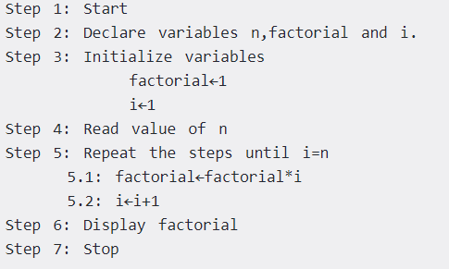
Task 1:Write an algorithm to find the factorial of a number entered by user

Slide 19
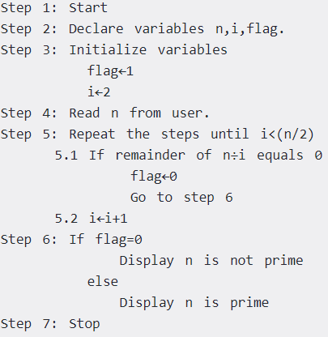
Task 2: Write an algorithm to check whether a number entered by user is prime or not.

Slide 20
Challenges
Write an algorithm to find the Fibonacci series till term≤1000
Write an algorithm to find the largest among three different numbers entered by user.

Slide 21
RECAP
What is an algorithm.
Is the use of algorithms really necessary in software development?
What are the guidelines for developing an algorithm?

Slide 22
Questions?
?

